Slide 1
Skin cancer identification
Classifying benign and malignant skin cancer images
Benjamin Blanc – Gautier Dulac – Léonard Fleutot – Annabelle Frin – Henri Matalon – Benjamin Sinturel

Slide 2

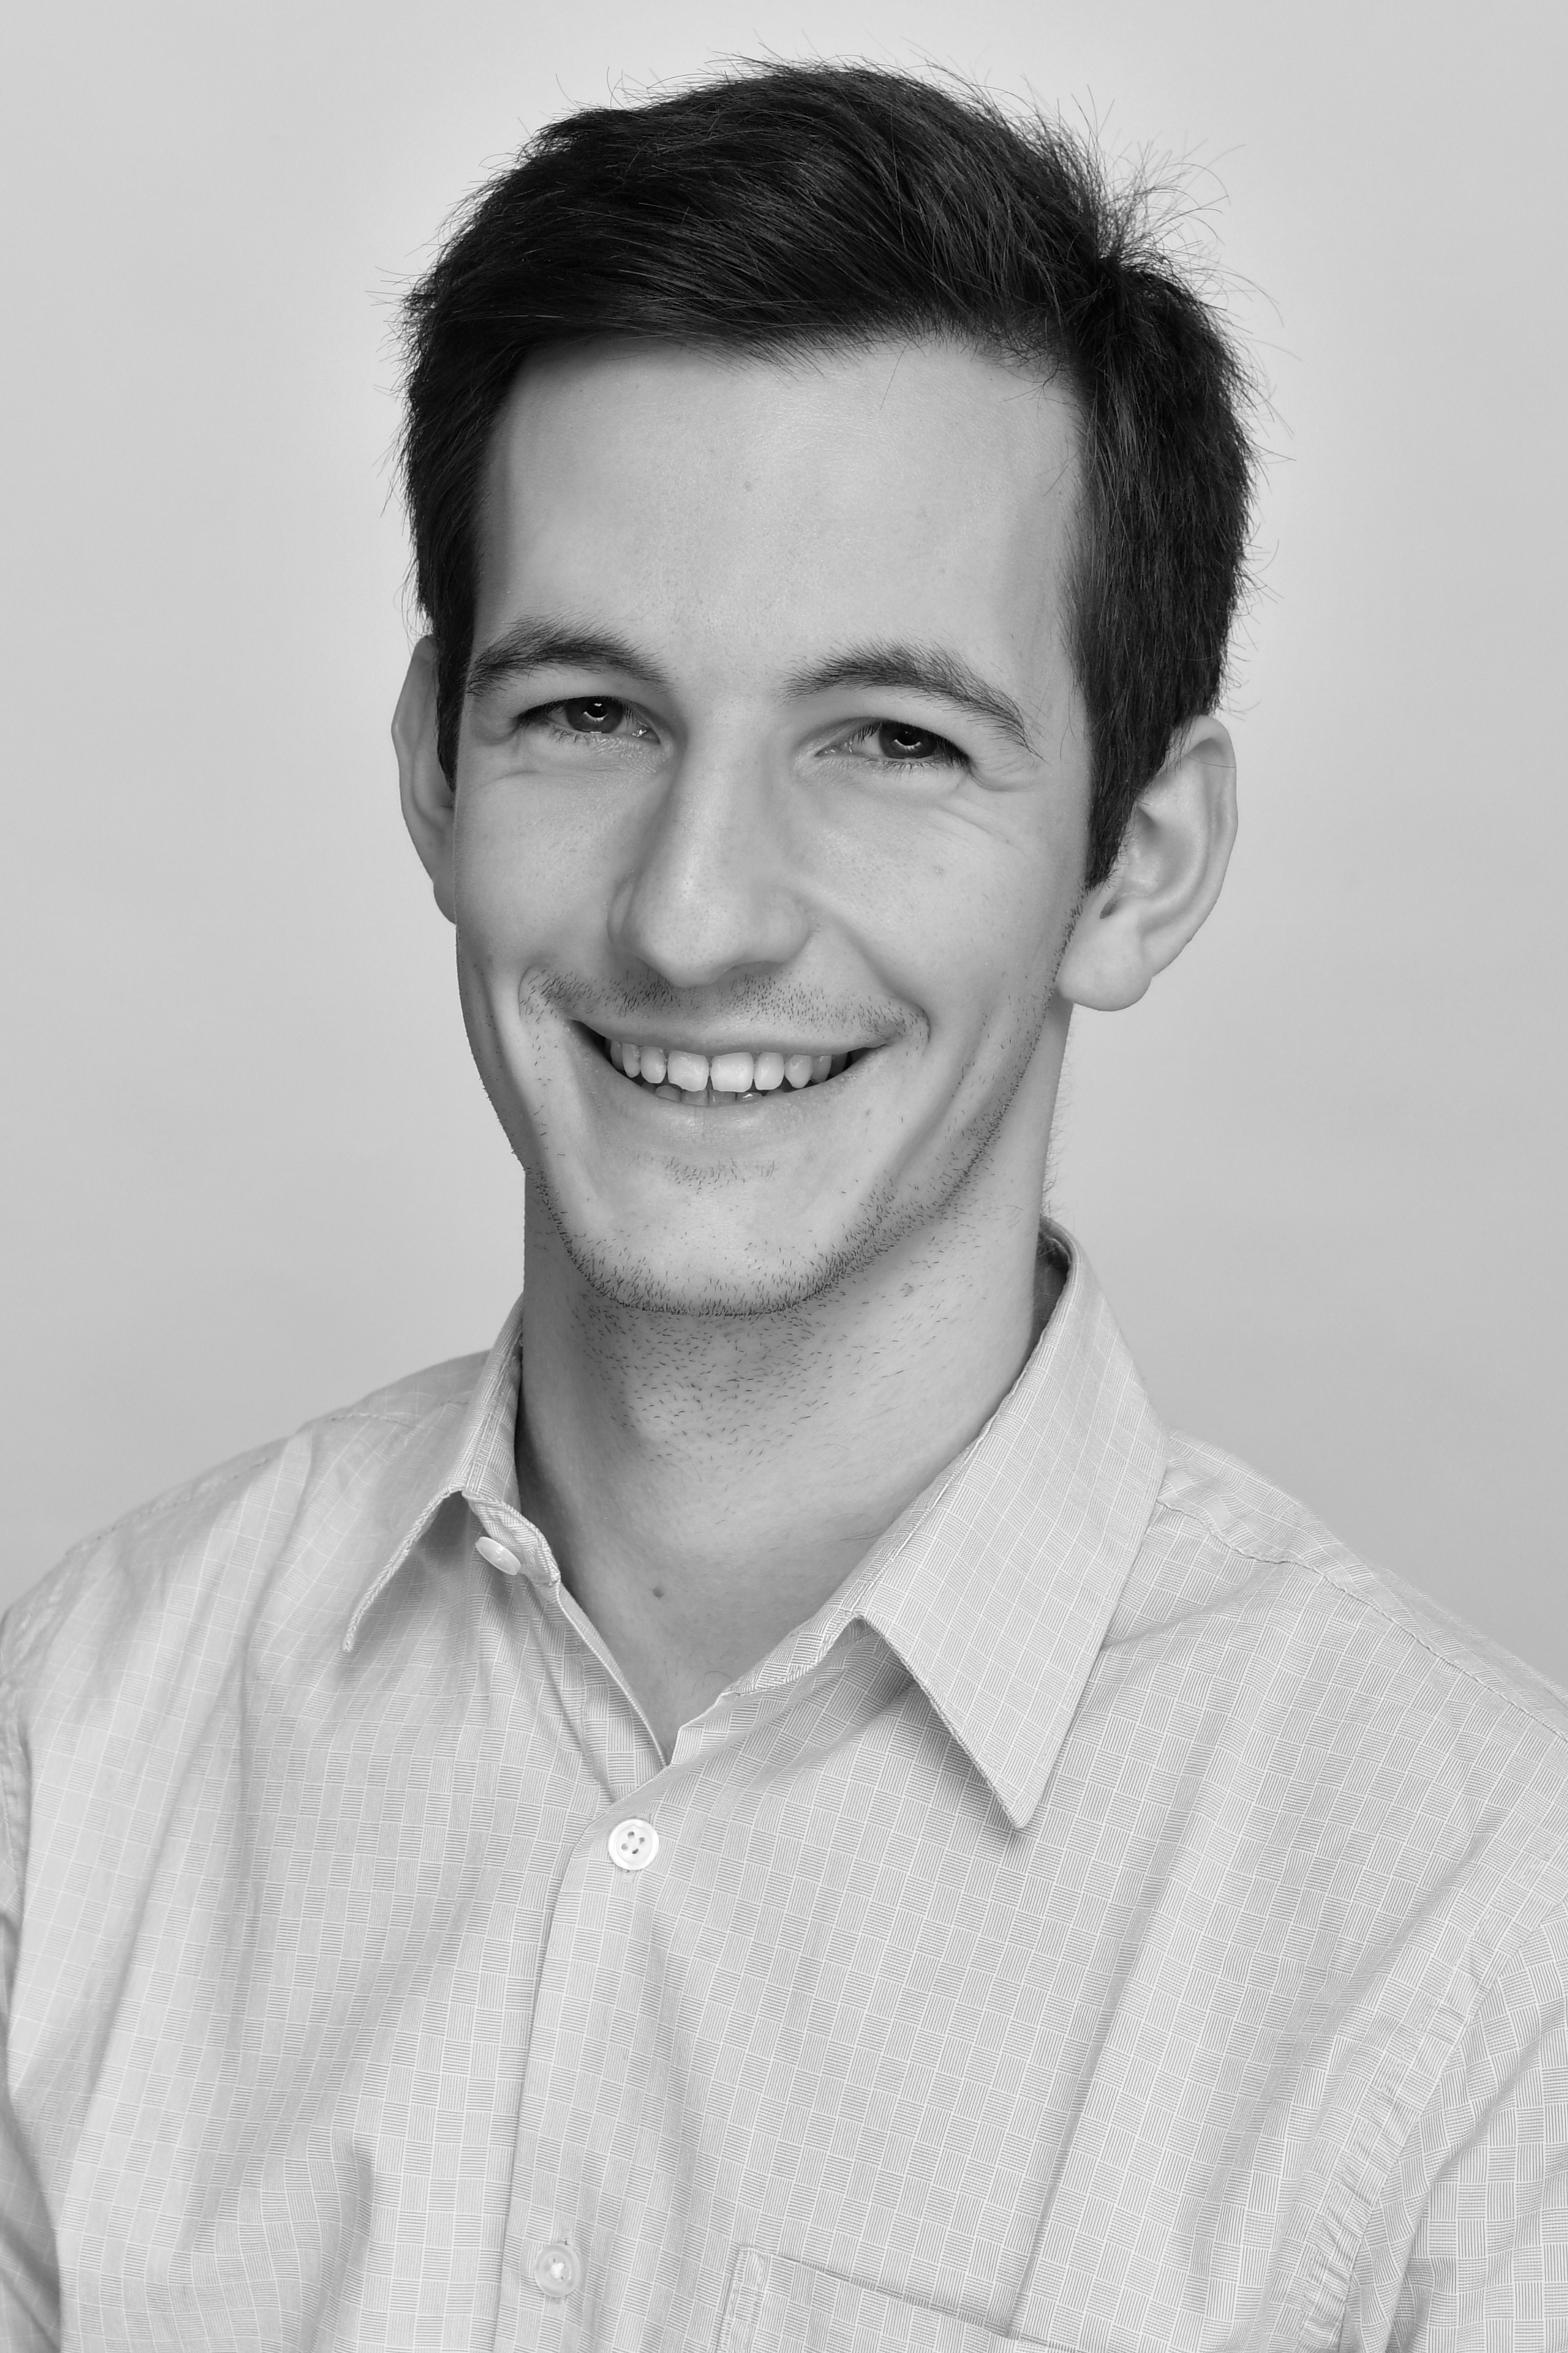
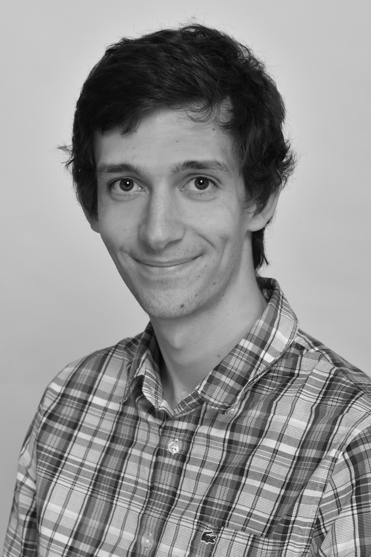
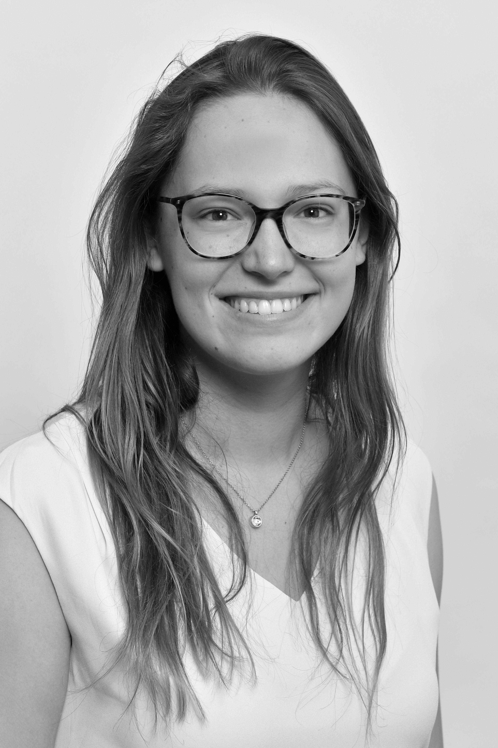
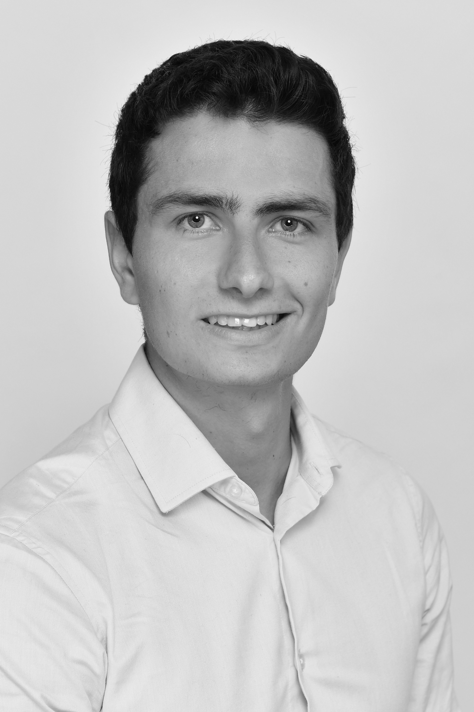
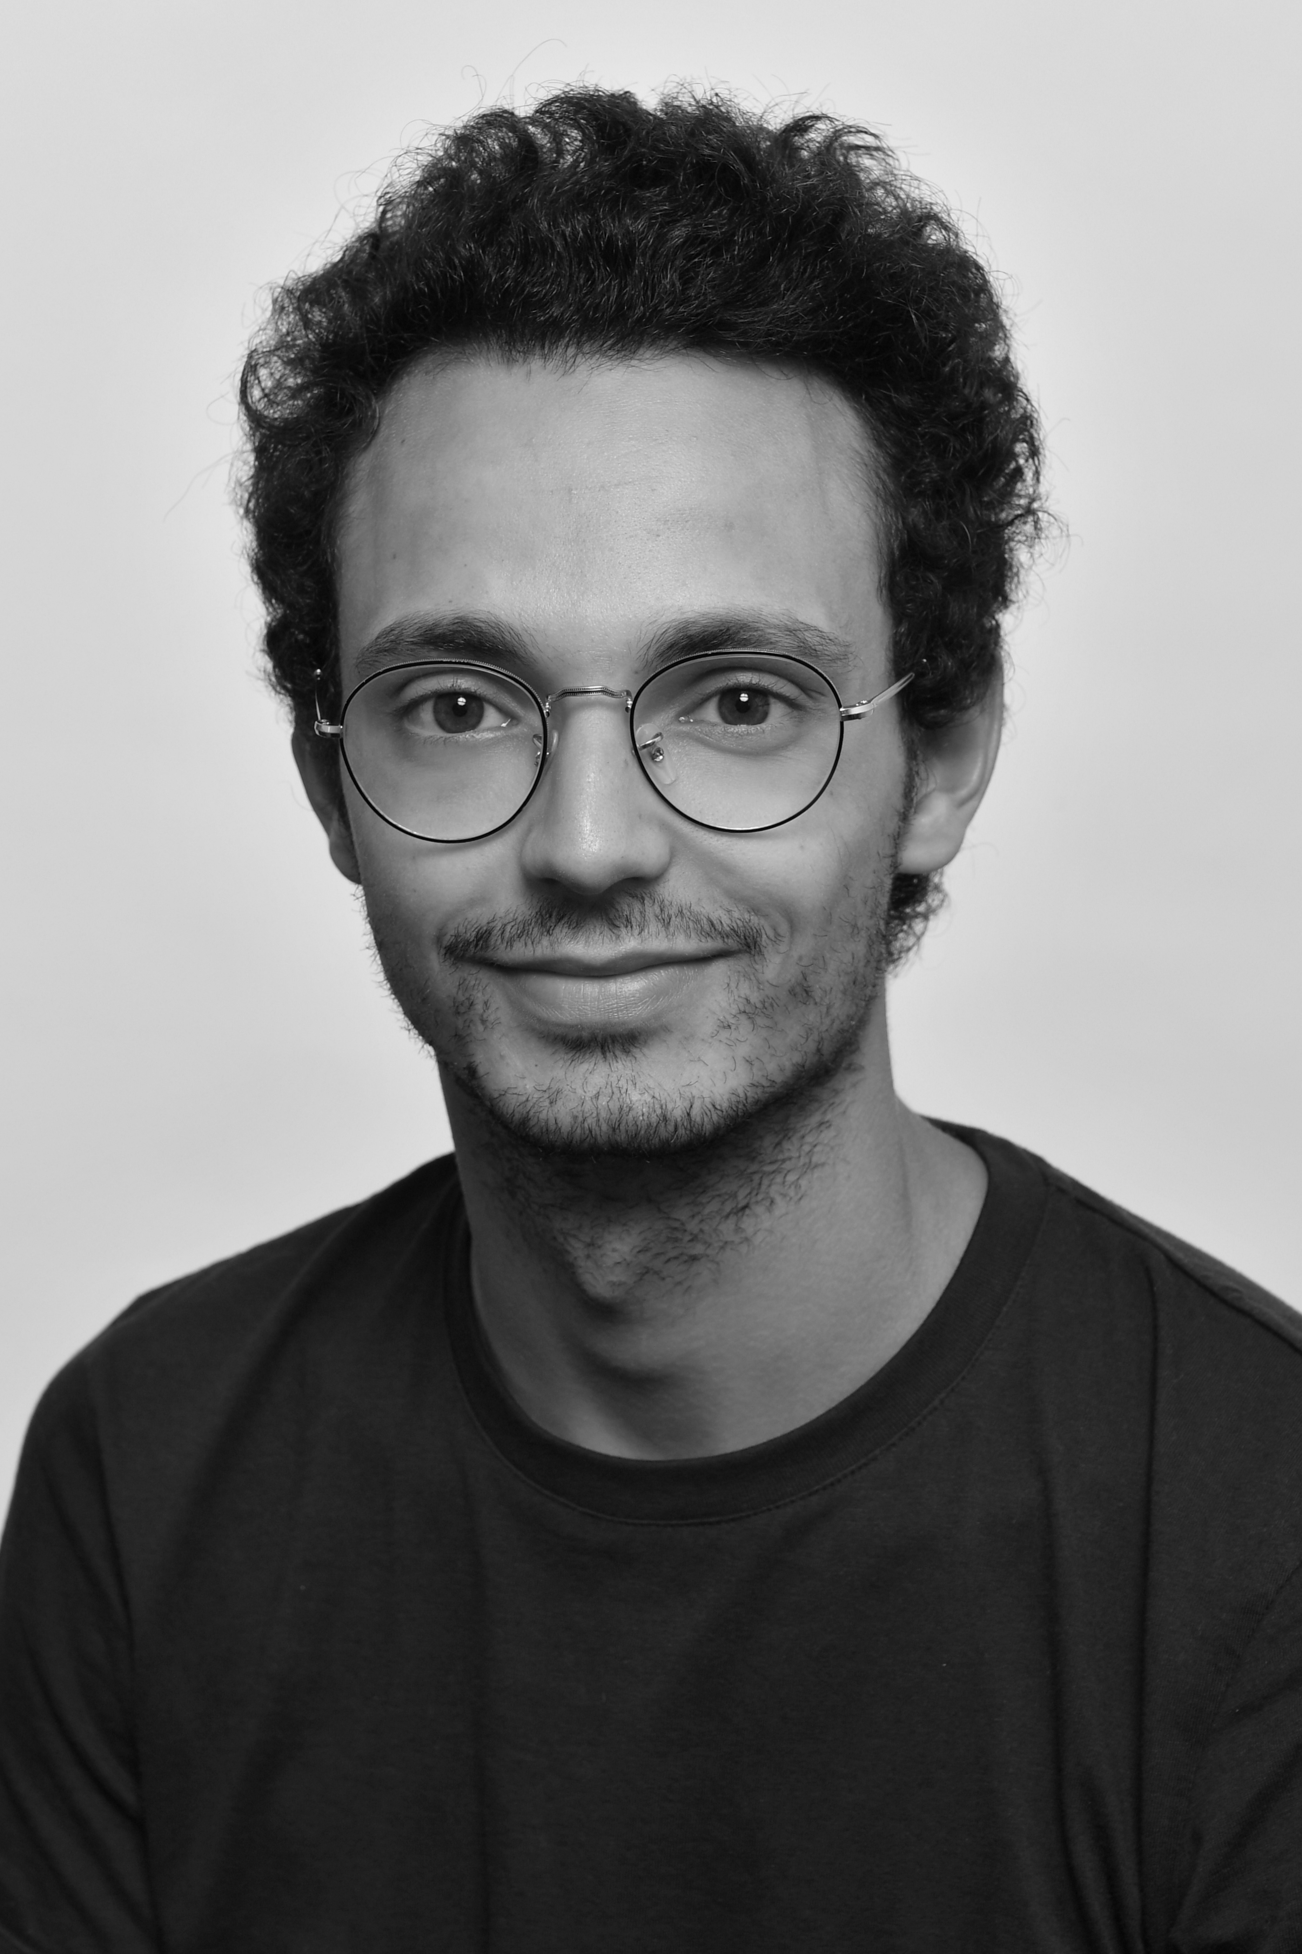
The team
Benjamin Blanc
Léonard Fleutot
Annabelle Frin
Henri Matalon
Gautier Dulac
Benjamin Sinturel

Slide 3
01
TABLE OF CONTENTS
02
03
One constraint: deploying it at large scale
Live demo
04
One goal: saving life
One way: automating skin-cancer detection

Slide 4
01
One goal: saving life

Slide 5
An increase of skin cancer incidence
1 in 3 |  | 1 in 5
cancers diagnosed is a skin cancer. |  | Americans will develop skin cancer in their lifetime.
+2 |  | x 2
people die of skin cancer in the U.S. every hour. |  | Having 5 or more sunburns doubles your risk for melanoma.
According to the World Health Organization and the Skin Cancer Foundation

Slide 6
Early detection saves lives
Skin cancer is the cancer you can see
Skin cancer is the cancer you can survive
Unlike cancers that develop inside the body, skin cancers form on the outside and are usually visible.
When detected early, the 5-year survival rate for melanoma is 99 percent.
Automating skin-cancer identification
People take a picture of their skin (mole, spot, open sore…) and know if they have to worry or not

Slide 7
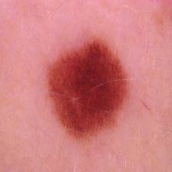
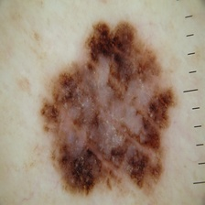
The ISIC Melanoma Project
The International Skin Imaging Collaboration is an academia and industry partnership designed to facilitate the application of digital skin imaging to help reduce melanoma-related deaths and unnecessary biopsies
Create a public archive of clinical and desmoscopic images of skin lesions
educate professionals and the public in melanoma recognition
automate diagnosis of melanoma
Benign
Malignant

Slide 8
The ISIC Melanoma Project
The International Skin Imaging Collaboration is an academia and industry partnership designed to facilitate the application of digital skin imaging to help reduce melanoma-related deaths and unnecessary biopsies
Create a public archive of clinical and desmoscopic images of skin lesions
educate professionals and the public in melanoma recognition
automate diagnosis of melanoma
3297 pictures (224x224)
2 types of moles: Benign and Malignant (balanced dataset)
Benign
Malignant

Slide 9
02
One way: automating skin-cancer detection

Slide 10
Preventing overfitting-risk
From a well balanced dataset…
…to 3 different datasets (training, validation, test)

Slide 11
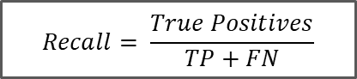
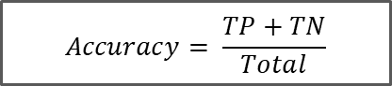
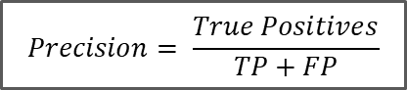
Metrics
What is the most relevant metric for our use case ?
$$Accuracy= \frac{TP+TN}{Total}$$
$$Precision= \frac{True Positives}{TP+FP}$$
$$Recall= \frac{True Positives}{TP+FN}$$
How accurate are the labels ?
If you are detected as malignant, how likely is it to be truly malignant ?
Among the malignant images, how many have been flagged correctly ?
Minimizing the wrong labels
Minimizing the benign detected as malignant
Minimizing the undetected malignant

Slide 12
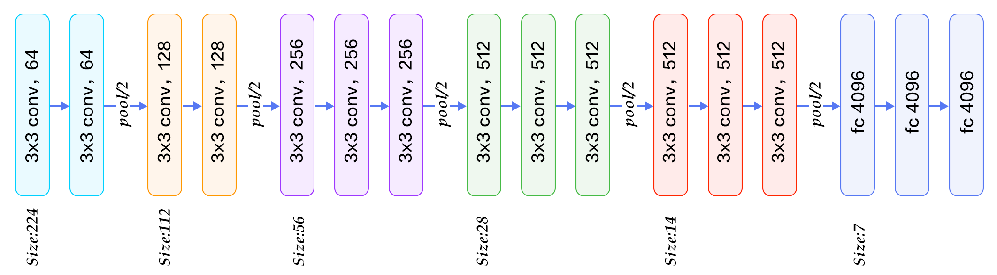
VGG network: a deep convolutional network for image classification
Principles & structure
Application: for a given image, find object name in the image
Input: image of size 224*224*3 (RGB image)
Trained model size: 528MB
Architecture: 16 layers
Convolution layers (used only 3*3 size)
Max pooling layers (used only 2*2 size)
Fully connected layers at end
Easy to use: Structure and weights of the trained network freely available online

Slide 13
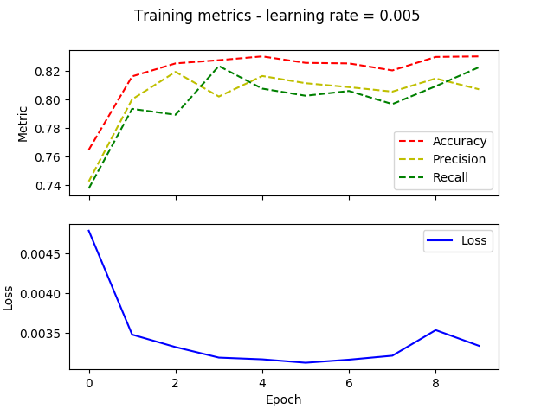
VGG network: a deep convolutional network for image classification
Performances on our dataset
Performances on train set
Performances on test set
Loss | 0.0159
Accuracy | 0.7936
Precision | 0.8011
Recall | 0.7194

Slide 14
03
One constraint: deploying at large scale

Slide 15
Internet connection: a production constraint to deploy VGG network
perform complex task
VGG network:
a sophisticated model that can
A reliable internet connection
is required
Internet connection becomes a production constraint!
be deployed to the cloud and call whenever we need its service
Difficult to deploy on mobile devices for instant usage

Slide 16
Small is beautiful
Objective: creating a small network
that will be able to produce comparable results but on mobile devices
1
MobileNets
2
In-house network
3
Resnet18

Slide 17
MobileNet v2
A smaller portable network for image classification

Slide 18
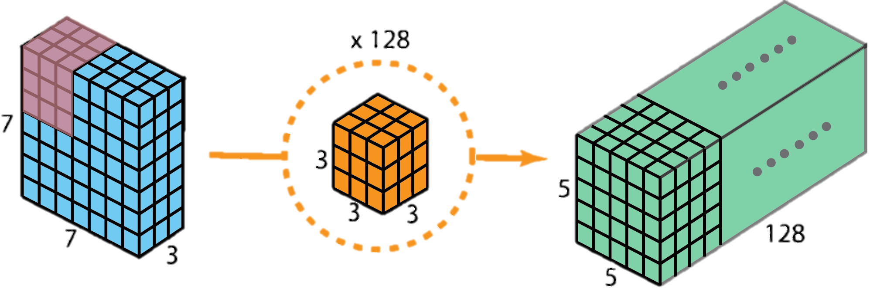
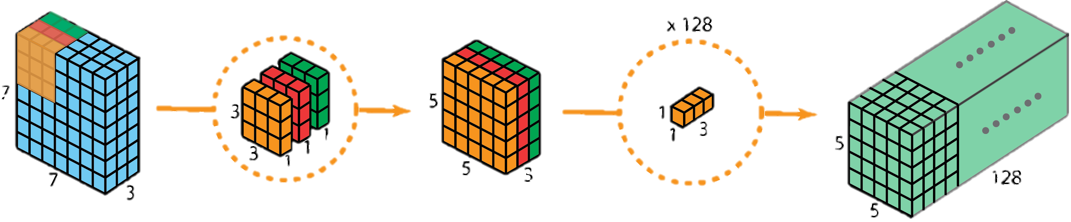
MobileNet v2: a smaller portable network for image classification
Principles & structure
Same application, use and input as VGG
Trained model size: 13.4MB
Architecture:
Base building block using depthwise separable convolutions

Slide 19
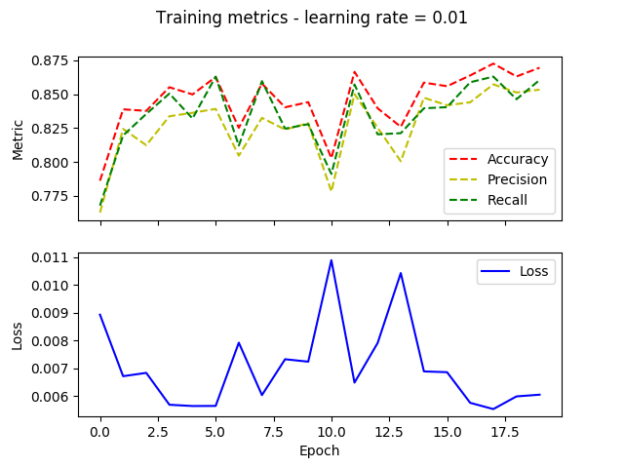
MobileNet v2: a smaller portable network for image classification
Performances on our dataset
Performances on train set
Performances on test set
Loss | 0.0954
Accuracy | 0.8417
Precision | 0.8128
Recall | 0.8418

Slide 20
In-house network
A simpler convolutional network for image classification

Slide 21
In-house network: a simpler convolutional network for image classification
Principles & structure
18@224x224
18@28x28
48@28x28
3@224x224
2D Convolution
8,8 Maxpooling
2D Convolution
48@14x14
1x64
Benign
Malignant
2,2 Maxpooling
Dense -Softmax
Dense -Softmax

Slide 22
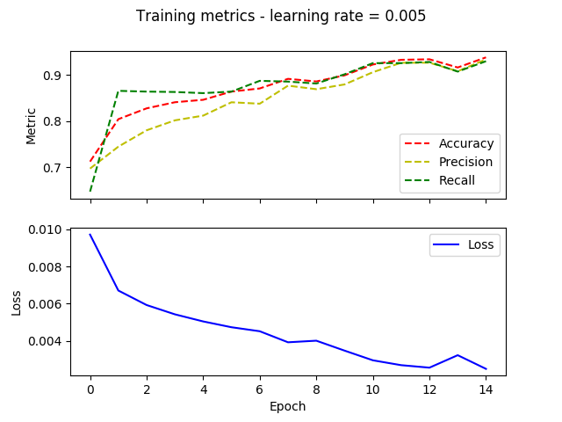
In-house network: a simpler convolutional network for image classification
Performances on our dataset
Performances on train set
Performances on test set
Loss | 0.1263
Accuracy | 0.8234
Precision | 0.8083
Recall | 0.7959

Slide 23
Resnet18
A modular convolutional network for image classification

Slide 24
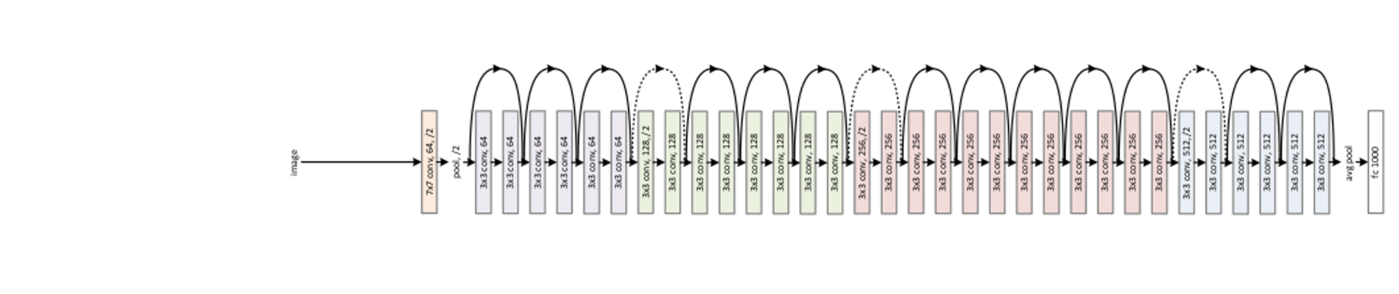
Resnet18: a modular convolutional network for image classification
Principles & structure
Model size: 44.7 MB
Architecture: 18 layers
Connexions between layers
Easy to use: Structure and weights of the trained network freely available online
Application: for a given image, find object name in the image
Input: image of size 224*224*3 (RGB image)

Slide 25
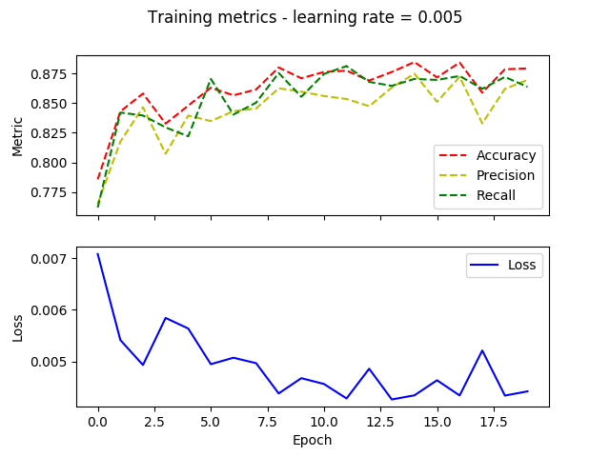
Resnet18: a modular convolutional network for image classification
Performances on our dataset
Performances on train set
Performances on test set
Loss | 0.0935
Accuracy | 0.8188
Precision | 0.8000
Recall | 0.7959

Slide 26
Global benchmark between used networks
Performances on test set:
 | VGG-16 | MobileNetV2 | Resnet-18 | In house net
Loss | 0.0159 | 0.0954 | 0.0935 | 0.1263
Accuracy | 0.7936 | 0.8417 | 0.8188 | 0.8234
Precision | 0.8011 | 0.8128 | 0.8000 | 0.8083
Recall | 0.7194 | 0.8418 | 0.7959 | 0.7959

Slide 27
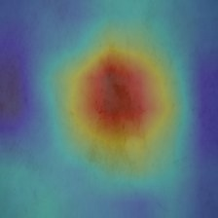
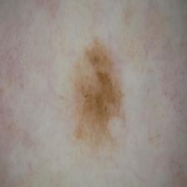
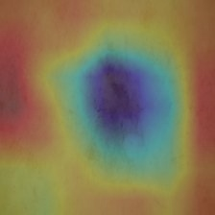
Activation map confirms the result
Original image
Activation map images
Malignant
99,99%
Benigm
0,01%

Slide 28
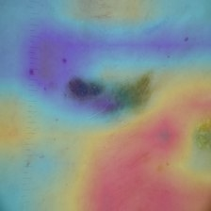
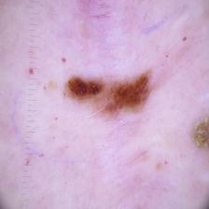
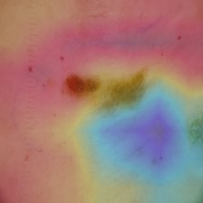
Activation map infirms the result
Original image
Activation map images
Malignant
55,95%
Benigm
44,05%

Slide 29
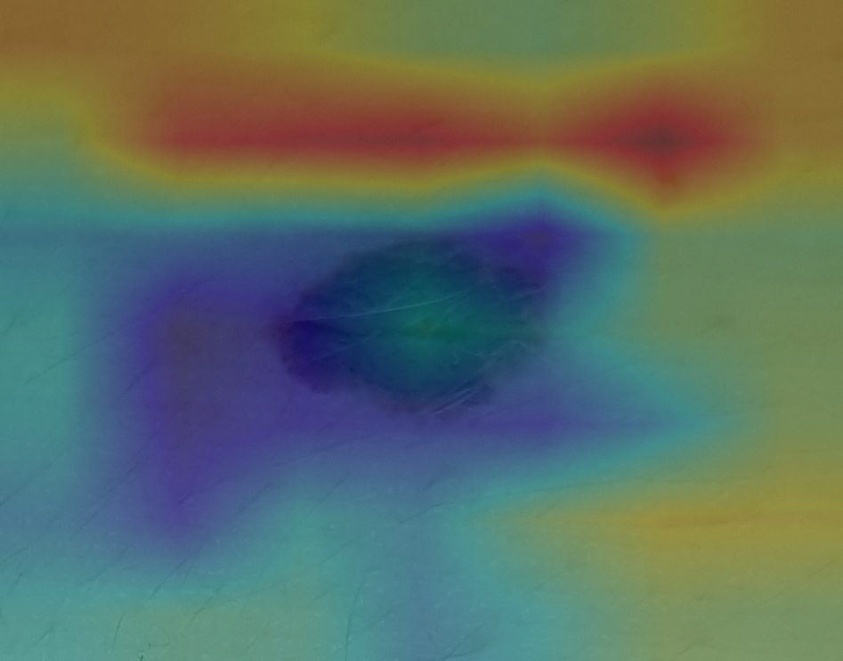
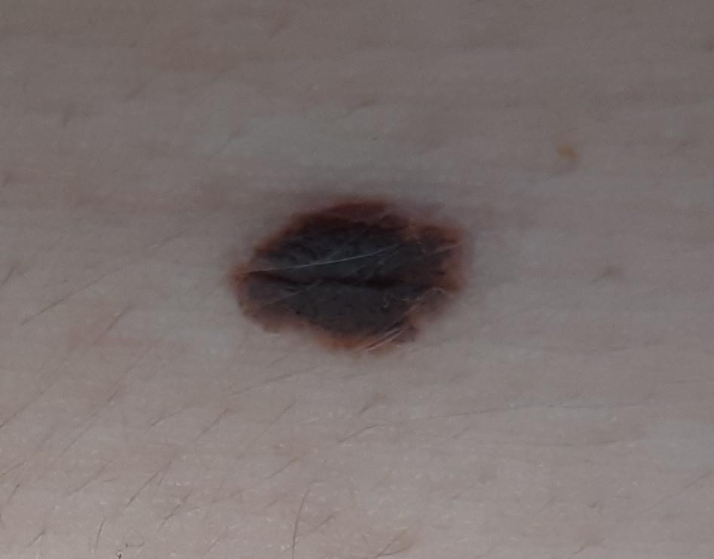
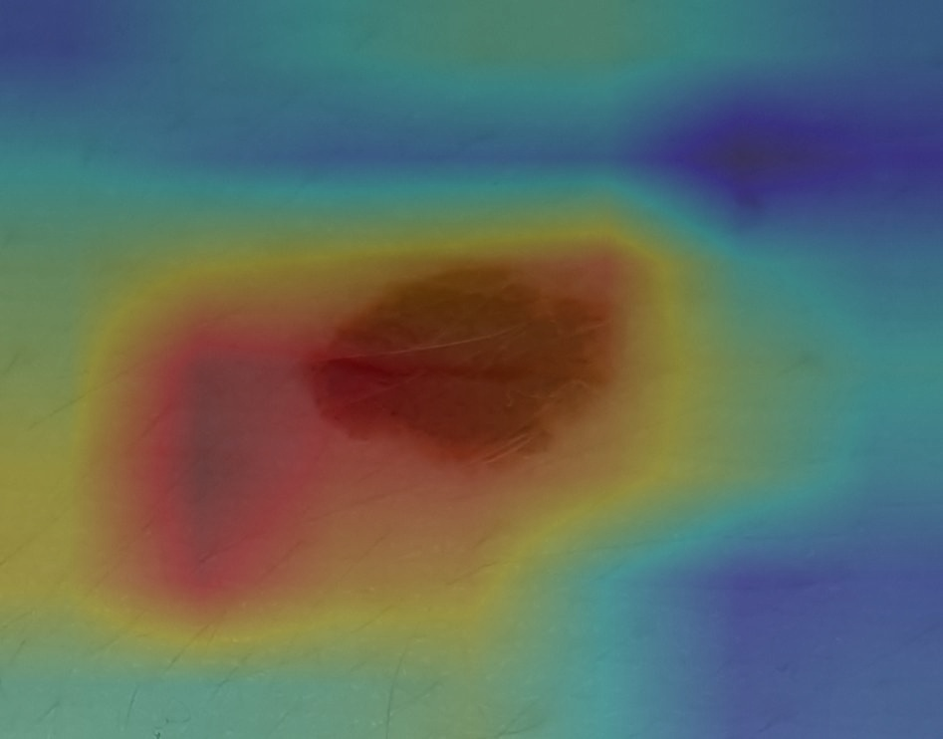
Annabelle
Original image
Activation map images
Malignant
13,95%
Benigm
86,05%

Slide 30
04
Live demo

Slide 31
Improving photo quality
ADDITIONAL THOUGHTS
Adding a recall penality to loss function
Taking into RGPD regulation

